Slide 1

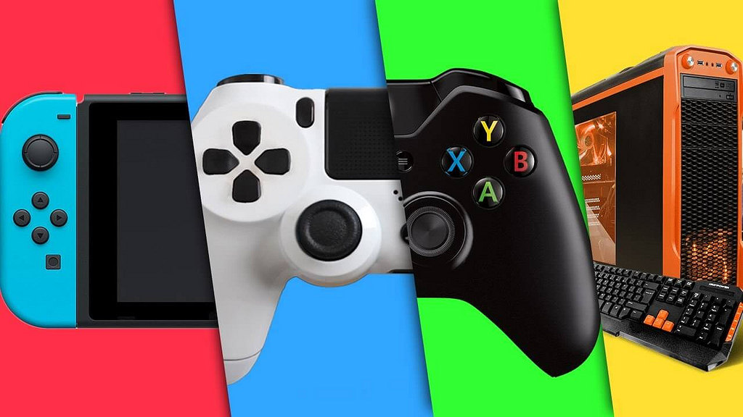
Reviewing Game Design
Matthew Sides

Slide 2

Game Design-What is it?
Game Design:
Broad Overview - Ideology Behind the game
Without Game design there is no Game
Considerations:
How it will flow?
Trends & Market research – What gamers want?
Role:
Game Design Perceived differently based on role
Notes:
Game design in broad terms refers to the ideas or ideology behind the development of the game (Duffy, 2007). In essence "it is the art of applying design and aesthetics to create a game for entertainment or for educational, exercise, or experimental purposes" (Wikipedia, 2018). According to Jesse Schell an American video game designer, as reported by McKeever (2016), “Game design is the act of deciding what a game should be”. Considerations required to take in during the design phase of a game, pertain to how the game will flow from start to end, the games purpose and whom or what the target audience that is aimed to be achieved wants (All ArtSchools, 2018). The importance of Game design has seen dedicated fields of studies and a trend of people whom soley focus on design rather than code. Game designs importance in relation to the role is relative, meaning that it impacts various roles such as stakeholders, developers, artists, producers, level/characters/story designers and players differently. For instance to a player game design is vital for the concepts of experience, engagement, and enjoyment, this is also fundamentally important in a developers considerations when approaching game design. However, Game developers view game design as a crucial component, as developers are tasked with the creation of the game based on the ideas fleshed out in the game design, thinking up the most optimal ways to convey and display the ideas making the game a reality. Thus, without the game design there is no game to make meaning that game developers would be obsolete. In relation to a CEO , Game design is important with regards to how it could be marketed, distributed, keeping operational efficiency and bottom line profit focusing on strategic intrests. This is essentially similar to how stakeholders view game design as in how a profit could be made from it and is vital to get the stakeholders to pledge money towards the project as stakeholders are usually briefed and given a presentation before a full development proccess takes place. If game design did not take place the CEO would have nothing to market, whilst stakeholders would also have nothing to put money towards or make any profit (Wu, 2017). Game design for artists pertains to implementing a game designers idea, Artists are responsible for creating a unique visual experience for the user by creating art assets that resonate with the game design, however if there is no game design then the artist cannot bring anything into fruition. A game artist can demonstrate expertise as a game designer if he achieves seamless integration without sacrificing the artistic vision and compromising the platform’s technical limits (Backstage PassInstitue, 2017). A game designer is a multi facted role that requires communication with all those involved in development and are generally the drive behind the game, coming up with the initial ideas based on research and self inspiration, then working with other roles to make the conceptual idea come to fruition. Essentially Game design cannot be defined as one thing but is a cumulation of roles working in correlation to think of an idea and watch it come to fruition.

Slide 3
Explorational Timeline – Key Title Of each Decade (1960 – 2010)
1960 - Space Wars!
1970 - Pong
1980 – Donkey Kong
1990 - Super Mario 64
2000 - Halo 2
2010 - Fortnite

Slide 4
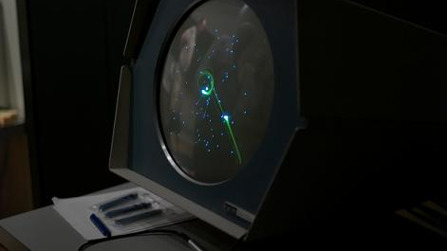
Timeline - 1960
Space War Concieved – first classifiable as a shoot em up
Notes:
Space Wars (1962) developed in the 1960's by Steve Russell in collaboration with Martin Graetz and Wayne Wiitanen, programmed by Russell with assistance from others including Bob Saunders and Steve Piner. Space Wars took inspiration from the writings of E. E. "Doc" Smith (an American food engineer and science-fiction author) and ran on the PDP-1's operating system (PDP-1 pertains to an early interactive mini computer), which concidently was the first to allow multiple users to share the computer simultaneously (Wilkipedia – Space War, 2018). This feature of the PDP-1 system was optimal for the design of Space Wars which sees two players, each with there own ships known as 'the needle' and 'the wedge' engaged in a dogfight, while maneuvering in the gravity well of a star. Each ship follows newtons law, meaning that regardless of a lack of thrust from the player the ship would continue to move, whilst the ships would also have a limited amount of torpedos and fuel for maneuvering. Furthermore, ships would also be destroyed upon being hit by a torpedo or colliding with the star. Whilst players can engage a hyperspace feature to move to a new, random location on the screen, though each use has an increasing chance of destroying the ship instead. The game was almost the first created, however there were at least two far-lesser-known predecessors: OXO (1952) and Tennis for Two (1958).
The importance of Space Wars and the development that ensued post release, stems from the inconceivable fact that Space Wars defined its genre, being the first Shoot em up, whilst at the same time elements of multiplayer are seen in practice for the first time as players are pitted against one another. Moreover, evidence of it's impact can be seen through the first commercial arcade video games, Galaxy Game and Computer Space (1971) and later games such as Asteroids (1979) (predominantly a game of significance in its own right) which Space Wars is said to have inspired. Steve Russell is quoted by Bellis (2017) as stating that' "If I hadn't done it, someone would've done something equally exciting if not better in the next six months. I just happened to get there first.". It is also important to note that Steve Russell, in addition to his title 'Space Wars', played a predominant role in gaming history as he introduced computer game programming and Space War to Nolan Bushnell, whom went on to create the first coin-operated computer arcade game and started Atari Computers.

Slide 5

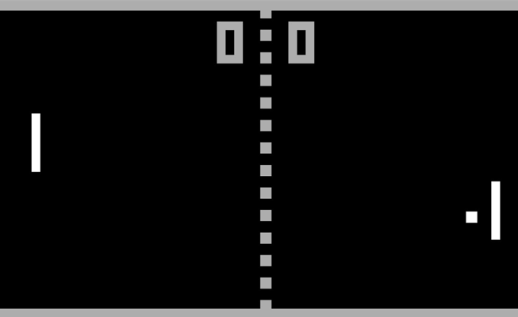



Timeline - 1970
Pong formulated by Allan Alcorn – first commercially successful game
Notes:
Pong (1972) was developed by Allan Alcorn, whom was assigned the task as training by Atari co-founder Nolan Bushnell (Wikipedia, Pong, 2018). Bushnell based the idea on an electronic ping-pong game included in the Magnavox Odyssey, which resulted in a lawsuit against Atari. Pong the two-dimensional sports game that simulates table tennis, consists of two 2D pixelated squares known as 'paddles' positioned on either side of the screen, a dotted line in the middle of the screen, a scoreboard represented by two numbers side by side and a ball which collided with the Y axis walls and two Squares. Pong functioned by allowing the player to control an in-game paddle moving it vertically across a screen (either right or left), competing against either another player or AI, the paddles were used to hit a ball back and forth. The end goal in pong is to reach eleven points before an opponent, these points are earned when one fails to return the ball to the other.
The importance of Pong is illustrated through its commercial success (1973 - 2500 orders fulfilled, 1974 - 8000 units plus sold, overall 35,000 units sold at three times the price of production at its height), being the first commercially successful video game, this brought about the foundations of the video game industry along with the first home console, the Magnavox Odyssey (Centre for computing history, no date). Moreover, following its release several other companies began producing copies in regards to the games mechanics, eventually releasing new types of games which spurred Atari to encourage the innovation of games among its staff. In 1974, Atari engineer Harold Lee proposed a home version of Pong that would connect to a television: Home Pong. Furthermore, following its limited 1975 release through Sears; around 150,000 units were sold and became Sears' most successful product during the time, earning Atari a Sears Quality Excellence Award. It is important to note that the several companies that went on to release clones to capitalise on the success, also went onto produce new consoles and video games. For instance, Magnavox whom rereleased their Odyssey system with simplified hardware and new features, later releasing updated versions. Coleco also entered the video game market with their Telstar console which featured three Pong variants, also succeeded by newer models. Nintendo released the Color TV Game 6 in 1977, which played six variations of electronic tennis. The next year, it was followed by an updated version, the Color TV Game 15, which featured fifteen variations. The systems were Nintendo's entry into the home video game market and the first to produce themselves—they had previously licensed the Magnavox Odyssey (Lupton, 2017).

Slide 6
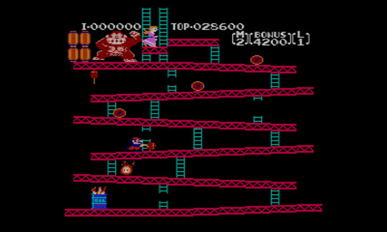
Timeline - 1980
Donkey Kong- Kickstarted Shigeru Miyamotos Career and solidified Nintendos position.
Notes:
Donkey Kong, released in 1981 as an effort to break into the North American market, is an arcade game licensed by Nintendo and developed by nintendo employee 'Shigeru Miyamoto' . The game consists of ascending and manouvering the main character across a series of platforms while dodging and jumping over obstacles and is considered one of the most influential and important games during an golden age for arcade games. In relation to story, the game is based on the cliché of a damsel in distress, kidnapped by a giant ape (known as Donkey Kong) and tasks the main character, originally named Mr. Video, then Jump man and now Mario, with saving the damsel (Wikipedia, 2018). Although the game did cause Nintendo to experience a lawsuit by Universal City Studios (Now known as Universal Studios), alleging Donkey Kong violated their trademark of King Kong, ultimately failed. Following the success of Donkey Kong and Nintendo's victory in court, helped solidify the company's position and set the company up for market dominance from its release in 1981 until the late 1990s (1996–1999).
Donkey Kongs importance can be seen to extend past its release, creating the Jump-and-run platform genre, launching 'Shigeru Miyamoto' (an influencal game designer) career whom went on to create titles influenced by this idea such as 'Mario Bros (1983),which has been ported to Nintendo affiliated consoles, and its critically acclaimed predecessor 'Super Mario Brother' (Wikipedia, 2018 and Fahs, no date). Moreover establishing Nintendo as perhaps the industry's longest standing superpower.
Other Important mentions include Moon Patrol and Jungle Hunt both released in 1982, whom popularized Parallax scrolling in 2D computer graphics and video games. Along with the 1981 arcade game Jump Bug where the camera technique was first used. This mechanic and the ideology behind parallax scrolling is re-factored by Shigeru Miyamoto in his Mario games and many other games still developed today hence the mention (Wikipedia, 2018).

Slide 7
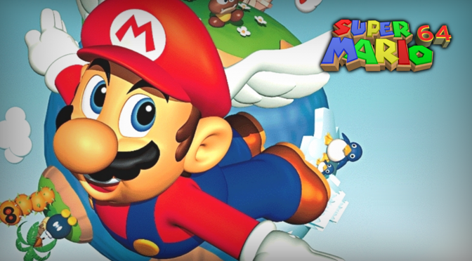
Timeline - 1990
Super Mario 64 – Revolutionary 3D open ended free roaming worlds
Notes:
Nintendo's Super Mario 64 (1996) developed by Nintendo for the release of the Nintendo 64 console. Super Mario 64 It is the is the best-selling game on the Nintendo 64, with more than eleven million copies sold and acclaimed as one of the greatest video games of all time. The three dimensional platformer entailed roaming Princess Peach's castle, entering portals, exploring vast worlds completing linear or optional missions to rescue her from Bowser (Wikipedia, 2018). Mario 64 was revlutionary for its 3D open-ended free roaming worlds, which had rarely been seen in 3D games before, along with its analog stick controls and camera control, featuring a dynamic camera system and 360-degree analog control. In contrast to previous titles Mario 64 included an element of freedom in regards to progression, with level design encouraging exploration and puzzle solving (Wikipedia, 2018). With multiple tasks and stars scattered about each level and thought required for certain tasks in a quest to unlock more areas of the castle .
The importance of Super Mario 64 doesn’t lie soley with the game itself but the technology and system it featured on. Super Mario 64 pushed the boundaries with its relatively large areas composed primarily of true 3D polygons as opposed to only two-dimensional (2D) sprites going beyond in-cartridge chip workarounds that had made some effects possible on the SNES - 64-bit brought the power for unique experiences. The SNES era had been largely 2D as per the technological limitations, with some titles utilising SuperFX to push the hardware further. Hence when the N64 put polygons at the core of its look and Super Mario 64 launched with this new hardware the game established a new archetype for the 3D genre, much as Super Mario Bros. did for 2D sidescrolling platformers changing the face of gaming (Whitehead, 2015). The N64 controller analog stick which is attributed to being designed and added primarily for Super Mario 64 also changed the format as 360 view and movement was made possible, before the Dpad was used for movement.

Slide 8
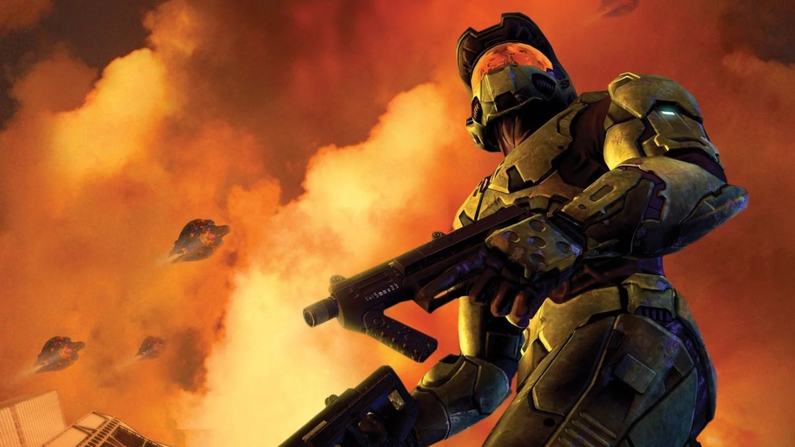
Timeline - 2000
Halo 2 – Introduced new form of Matchmaking and Regenerating health with no health packs.
Notes:
Halo 2, a 2004 first- person shooter is the sequel to Bungies 2001 critically acclaimed Halo combat evolved. The game featured a new game engine, in addition to using the Havok physics engine; added weapons and vehicles, and new multiplayer maps. The player alternatively assumes the roles of the human Master Chief and the alien Arbiter in a 26th-century conflict between the human United Nations Space Command and genocidal Covenant. Halo's development was actually plagued with issues due to Bungies ambitous nature, technical restraints in the original xbox and time constraints. Halo 2 was originally supposed to feature elements and levels shown in its proceeding sequel Halo 3, however due to time and technical restraints most ideas had to be thrown out and were later rehashed for Halo 3. The E3 demo for Halo 2 is a testament to the issues with it being described as "all smoke and mirrors", since the final product differed from what the demo showed (Funk 2010). Chris Butcher a programmer in the development of Halo even stated that "The graphics engine that we showed at E3 2003, driving around the Earth city... That entire graphics engine had to be thrown away, because you could never ship a game on the Xbox with it," (Fahey, 2010) this is supported by the fact that during the demo parts of the enviroment had to be deleted out of scene in order to have it run and function properly. Fahey (2010) further notes that Chris Butcher went on to say that, "Through putting ourselves through hell, we were able to do a five-minute demo of it, but after we came back from E3 we had to admit that this graphics engine was never going to work - it was never going to support the kind of environments that are really important for a Halo game. So we literally scrapped the entire graphics engine and started from scratch." The restructuring of the engine meant that there was no playable build of Halo 2 for nearly a year, and assets and environments produced by art and design teams could not be prototyped.
However, despite what a Bungie employee described as a "Brutal development process", Halo 2 is an important game to the industry being the best-selling game on its respective console, the first-generation Xbox. Whilst the game also revolutionised multiplayer, helping populate Xbox live, bringing online to the massess and including many of the features that would set the standard for Microsoft's online service on the next machine. Halo 2 online introduced an entirely new paradigm for matchmaking players together. In earlier games, one person specifies a game type and map and configures other settings, before setting up his or her device as a game server and advertising the game to the world at large. Halo 2 introduced a "playlist" system that automated this process to keep a steady flow of games available at all times and layered a skill-ranking system on top (Wikipedia, 2018). In addition, the game also introduced the mechanic (or at least popularised it) of regenerating health with no health packs, a now popular feature seen in modern games (Gamespot.com, 2005).

Slide 9
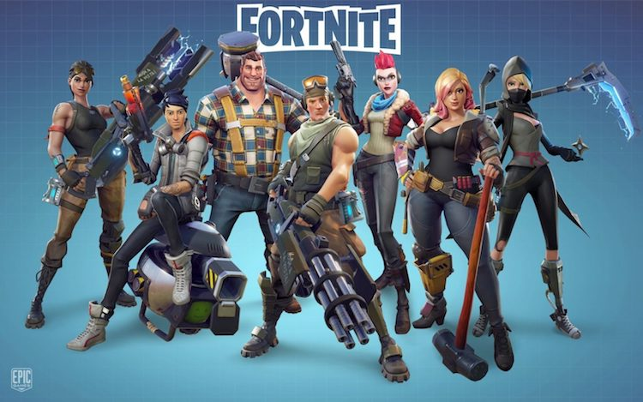
Timeline - 2010
Fortnite – Cultural Phenomenon, 200 Million player count, Millions of revenue earned monthly
Notes:
Fortnite is an online battle royale extravaganza developed by Epic Games using the Unreal engine (Epics open source Engine) and was released in 2017 in early access, although the idea was produced as early as 2011. The game is avaliable on all platforms, though as fortnite has multiple renditions for instance ; Fortnite: Save the World, Fortnite Battle Royale, Fortnite: Creative Save the World is available only for Windows, macOS, PlayStation 4, and Xbox One, while Battle Royale has been released for those platforms in addition for Nintendo Switch, iOS and Android devices. The gamemode covered in this section is soley the battle royale mode, which can be seen to take inspiration from similar games in the genre that came out earlier such as PUBG and the Battle Royale mod for ARMA 2/DayZ, developed by Brendan Greene (Wikipedia Battle Royale, 2018). Fortnite battle royale entails up to 100 players fighting to be the last person standing, using ingenuity, weapons and building tools/tatics to fight and survive the enslaught brought about by other players and the ever so close storm which forces the players to move towards a specific part of the map to speed up the elimination process and overall game speed (Wikipedia Fortnite, 2018).
The importance of Fortnite in gaming can be viewed through its world wide success becoming a cultural phenomenon making gaming more mainstream then ever where even non-gamers are aware of the game.Moreover in addition to its commerical success the use of the free to play structure and loot boxes has garned Epic millions a month in revenue with the player count peaking at about 200 Million (possibly more now) (Bailey, 2018). This has essentially solidified Epics position in the game industry and although the company was already known for its Unreal game engine, which used the underlying architecture of a first person shooter called Unreal that was originally developed and released but endured moderate success (Paumgarten, 2018), the company had yet to have an award winning title. It is important to note that the Unreal engine is also a symbolic and important milestone in the gaming industry as without this basic platform that supports all manner of games, many games would not exist or would have a different final design or outlook. Fortnite has recently also delved into the Mobile market, an evergrowing market which infact bests consoles in certain areas and has an influx of free to play games.

Slide 10
Conclusion
Industry evolution
Game designs evolved
More to consider and Higher expectations
Linked to enhanced technological breakthroughs
Industry Growth and Competition
Notes:
Following the research carried out in the previous slides it can be seen that during the early years of the industry development revolved around writing the least amount of code so that a game would fit into limited memory. This meant graphics and interactions would generally be very simple. However, as hardware has advanced, so has the game designer’s ability to illustrate and tell story's. In turn, graphics have become more detailed and interactions more complex. Fast forward to the modern industry, creating a game has become far more than just writing code: Also focused on defining user interactions, ensuring user engagement, and increasing overall enjoyment.
All this can be seen through the explorational timeline as in 1960 through to 1980s games generally focused on functionality and performance then features pertaining to multiplayer online and aesthetics. This is partly due to the fact that multiplayer hadn't been considered yet but mainly due to technological constraints not making interconnectivity plausible along with 3D or high end graphics. In the 1990's three dimensional graphics were used in Super Mario and most Nintendo 64 games, although the hardware was limited to how much it could render therefore the colors are basic in contrast to games in the 2000s and 2010.Following the timeline through to the 2000's and 2010 it is possible to see the development of Multiplayer and see how the service was refined to become what it is today, particularly in Halo 2 where the system was refined to be more user friendly and easier to navigate ensuring a game is always found. Whilst graphics along with lighting can be seen to improve dramatically as hardware improves and developers learn more about how to better utilise 3D graphics. Moreover in terms of story telling looking at the timeline it may be seen that the first two games included no story with Donkey Kong (1980) only vividly being able to show a story with pixelated graphics and no audio and only one objective. It isn't until around the 1990's that story telling has evolved to a point where cutscenes are provided with audio, 3D graphics and the player is given more fluidity in their actions. The 2000's sees a boom in story telling in particular as does 2010, though this is particularly because the industry has grown in size monumentally by now thus meaning more games are developed. In fact certain individuals and employees at the video game company EA have stated that recent trends shall see players and developers veer off single player games and that multiplayer gaming is the future a claim disputed by numerous notable figures in the industry such as the creative director of the critically acclaimed God of War (Ps4 exclusive, previously best selling game exclusive on the console which was recently eclipsed by Spider Man, 2018) Cory Barlog (Plessas, 2017).
In conclusion it can be seen that as technology has been developed, developers, designers, etc. have worried less about condensing the game, focusing more on functionality, story and graphics which have become a staple for games. Although this does not mean performance is not taken into account as more people are becoming contemporary frame rate and performance are vital therefore condensing code and other practices are still important, however more roles have been created and clearly defined in order to facilitate the ever-growing industry, thus meaning that people not associated with that area of work do not have to worry about those issues. Moreover the technological advancements, enhanced graphics/lighting and expanded features in games caused by competition between other companies and passionate developers has seen players become sated for more, increasing the expectations the player has on a game. The idea of trends has also altered the industry along with the formulation of additional genres in contrast to what was available around 1960's. The additional genres has enabled the idea of trends as certain genres and types of gaming peak and decline at certain times, it is now possible through analysing trends to figure out the next trend (popular genre or type of gaming) and develop a game around that information as it is what will most likely sell and bring in revenue. This is a stark contrast to the early years of the industry where it was in its initial stages and there were not as many game companies or consoles, thus theses companies tended to set the staple releasing revolutionary games or copy cats based on revolutionary games only after release rather than before and foreshadowing the rise or fall of a genre or type of gaming.

Slide 11
Biblography
All Art School, (2018). Game Programming vs. Game Design. Available at https://www.allartschools.com/game-design/game-programming-vs-game-design/ [Accessed: 21/12/2018].
Backstage Pass Institute of Gaming and Technology (2017). Available at: http://blog.backstagepass.co.in/career-in-gaming/why-game-design-is-important/ [Accessed: 23/12/2018].
Bellis. Mary, (2017). The History of Spacewar. Available at: https://www.thoughtco.com/history-of-spacewar-1992412 [Accessed: 21/12/2018].
Bailey. Dustin, (2018). Fortnites total player count is 200 million. Available at: https://www.pcgamesn.com/fortnite/fortnite-battle-royale-player-numbers [Accessed: 23/12/2018].
Centre for Computing History (no date). Available at http://www.computinghistory.org.uk/det/4007/Atari-PONG/ Accessed: 22/12/2018].
Duffy. Jill, (2007). Game Design, An Introduction. Available at http://www.gamecareerguide.com/features/411/game_design_an_introduction.php [Accessed: 21/12/2018].
Fahs. Travis (no date). The Secret History of Donkey Kong. Available at https://www.gamasutra.com/view/feature/134790/the_secret_history_of_donkey_kong.php?print=1 [Accessed: 22/12/2018].
Fahey. Roc, (2010). Better Than Halo: The Making of Halo 2. Available at: https://www.eurogamer.net/articles/better-than-halo-the-making-of-halo-2-article [Accessed: 23/12/2018].
Funk. John, (2010). Halo 2's Development Was a Gigantic Mess. Available at: https://www.escapistmagazine.com/news/view/99883-Halo-2s-Development-Was-a-Gigantic-Mess [Accessed: 23/12/2018].
Gamelife (2018). Available at https://www.gamelife.com/ (Space Wars image found on this site) (Accssed: 21/12/2018].
Gamespot (2005). No Halo game had a bigger impact on gaming than Halo 2. Available at: https://www.gamespot.com/forums/system-wars-314159282/no-halo-game-had-a-bigger-impact-on-gaming-than-ha-29327341/ [Accessed: 23/12/2018].
Lupton. Jonny, (2017). ATARI “PONG” IS 45 YEARS OLD TODAY! Available at https://www.funstockretro.co.uk/news/atari-pong-is-45-years-old-today/ (Pong image found on this site) [Accessed: 22/12/2018].
McKeever. Charles, (2016). The art of game design and its importance. Available at: https://coronalabs.com/blog/2016/11/08/the-art-of-game-design-and-its-importance/ [Accessed: 23/12/2018].
Paumgarten. Nick , (2018). How Fortnite Captured Teens’ Hearts and Minds. Available at: https://www.newyorker.com/magazine/2018/05/21/how-fortnite-captured-teens-hearts-and-minds [Accessed: 23/12/2018].
Plessas. Nick, (2017). God of War director calls out EA for nonsense stance on linear games. Available at: http://www.egmnow.com/articles/news/god-of-war-director-calls-out-ea-for-nonsense-stance-on-linear-games/ [Accessed: 23/12/2018].
Whitehead. Thomas, (2015). Mario History: Super Mario 64 – 1996. Available at: http://www.nintendolife.com/news/2015/08/mario_history_super_mario_64_-_1996 [Accessed: 23/12/2018].
Wikipedia (2018). Battle Royale . Available at: https://en.wikipedia.org/wiki/Battle_royale_game [Accessed:/23/12/2018].
Wikipedia (2018). Donkey Kong. Available at https://en.wikipedia.org/wiki/Donkey_Kong_(video_game [Accessed: 22/12/2018].
Wikipedia (2018). Game Design. Available at https://en.wikipedia.org/wiki/Game_design [Accessed: 23/12/2018].
Wikipedia (2018). Fortnite. Available at: https://en.wikipedia.org/wiki/Fortnite [Accessed:/23/12/2018].
Wikipedia (2018). Halo 2. Available at: https://en.wikipedia.org/wiki/Halo_2 [Accessed: 23/12/2018].
Wikipedia (2018). Mario Bros. Available at https://en.wikipedia.org/wiki/Mario_Bros [Accessd:/22/1]2/2/018].
Wikipedia (2018). Open World. Available at: https://en.wikipedia.org/wiki/Open_world [Accessed: 23/12/2018].
Wikepeida (2018. Pong. Available at https://en.wikipedia.org/wiki/Pong [Accessed: 22/12/2018]./
Wikipedia (2018). Parallax Scrolling. Available at https://en.wikipedia.org/wiki/Parallax_scrolling [Accessed: 22/12/2018].
Wikipedia (no date). Spacewar. Available at https://en.wikipedia.org/wiki/Spacewar [Accessed: 21/12/2018].
Wikipedia (no date). Super Mario 64. Available at: https://en.wikipedia.org/wiki/Super_Mario_64 [Accessed:/23/12/2018].
Wu. Elliott, (2017). Can the CEO of a AAA game company also be a game designer? Available at: https://www.quora.com/Can-the-CEO-of-a-AAA-game-company-also-be-a-game-designer [Accessed: 23/12/2018.]

